Slide 1


Expedia Hotel Recommendations
Team 17
Zouzi Qi LinLin Tan
Griffin Rodrigue Sandra Bamfo

Slide 2
Agenda
Expedia’s Business Model
Competition Overview
Critique of Public Solution
Dataset overview
Our Solution
Conclusions
Excel Output

Slide 3
Business Model
Expedia Group is one of the world’s largest online travel companies for consumer and business purposes. Expedia’s retail segment has several lines; Brand Expedia,Hotels.com,Vrbo,Orbitz, CheapTickets, Travelocity to a name a few.

Slide 4
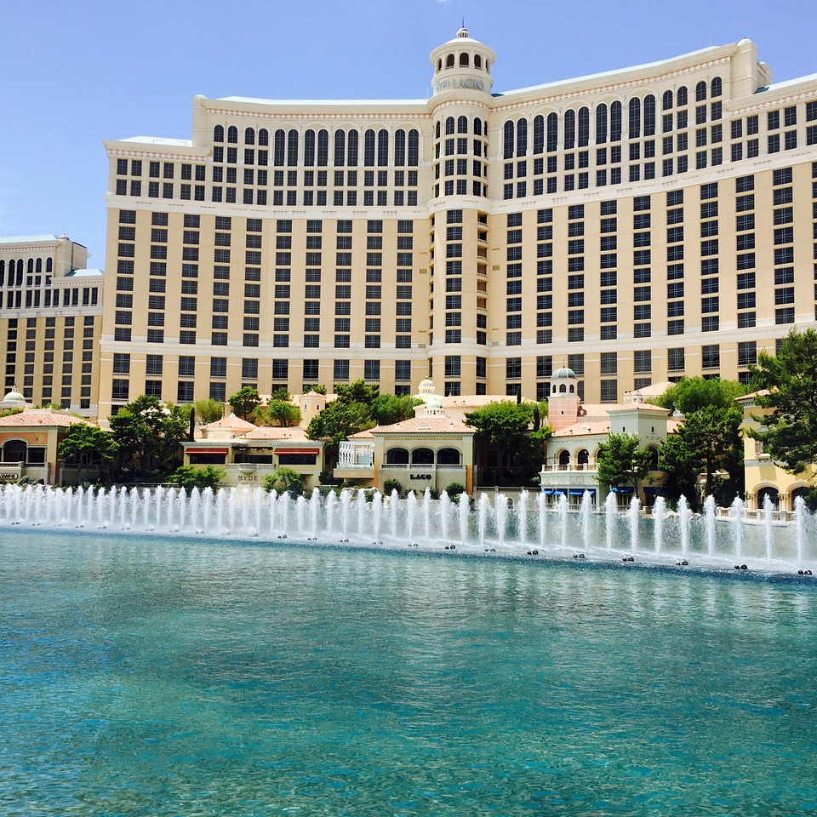
Competition Overview
Provide personalized hotel recommendations for expedia users.
Expedia uses search parameters to adjust their hotel recommendations, but there aren't enough customer specific data to personalize them for each user.
With hundreds, even thousands, of hotels to choose from at every destination, it's difficult to know which will suit your customer preferences.

Slide 5
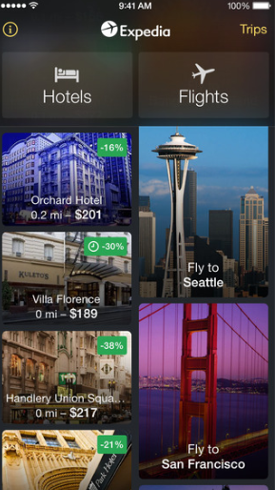
Project Objective
Our goal is to build a machine learning model to predict the booking outcome for a user, based on their search and other attributes associated with that user.

Slide 6

Competition
Data Description
General Data Description:
The data in this competition is a random selection from Expedia and is not representative of the overall statistics.
Train & Test Data Set:
Contains 23 features capturing the logs of customer behavior. Training data from 2013 and 2014, while test data are from 2015. Training data includes all click events and booking events. Test data only includes booking events.
Destination Data Set:
Contains 149 features pertaining to hotel reviews made by users.

Slide 7

Critique Of Public Solution One
PRO’S
Succinct PCA model
Outputs a pca plot to visualize the data.
Results:
Train Accuracy: 10% run with 180000 train data
CON’S
Was not tailored to individuals preferences. Purely based on popularity.
No other information given on performance
The code only do the rank the top 5 and finish the work.

Slide 8
Critique Of Public Solution Two
PRO’S
Compares several classification approaches. Such as Random Forest, K-means Clustering, Decision Trees and MLPClassifier.
Results:
Best Train Accuracy: 0.16511007338225483
CON’S
All the modules have a very low accuracy rate.
Additional tuning of the random forest model could have increased the accuracy.
Test Error: 1108.8155436
Notes:
ExpediaHotelCompetition | Kaggle

Slide 9

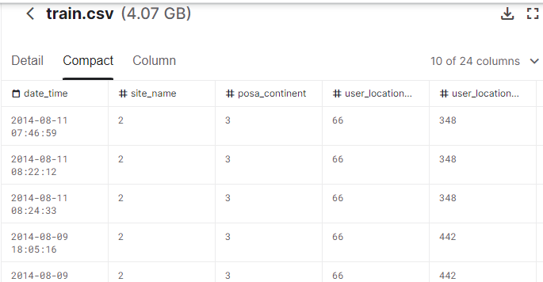
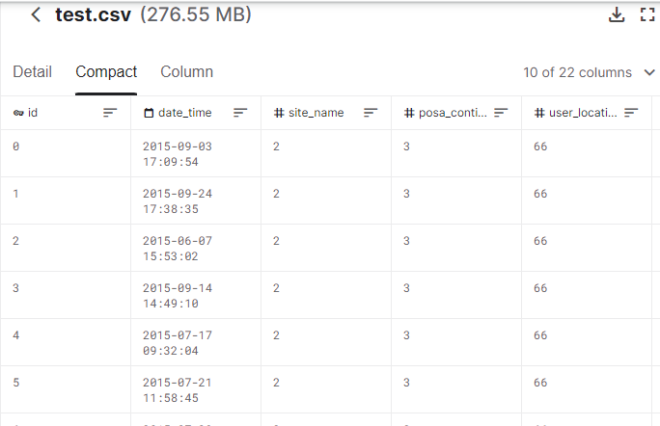
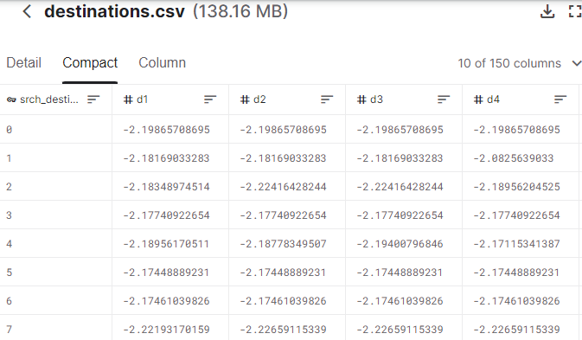
Data Overview:
The training set consists of 37,670,293 entries . (24 columns)
The test set contains 2,528,243 entries.(22 columns)
The destination set provides 64993 entries with 149 latent features.
We will use customer data and predict the likelihood a user stay at 100 different hotel groups.
We will provide not only a recommendation but rank the predictions and get top 5 hotel clusters to each user in the test set.
The difference between the train and test set is train set with people who do not booking the hotel just only do the search.

Slide 10

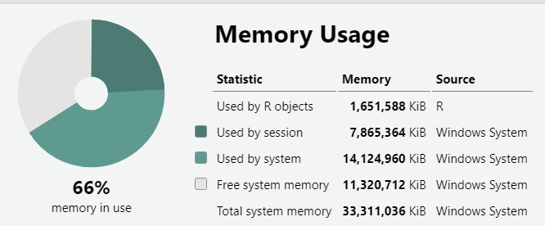
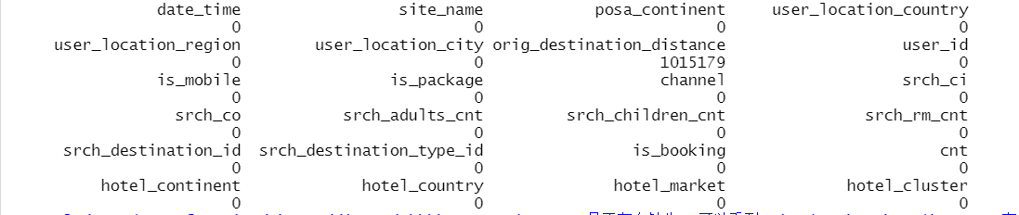
What's the question?
Which hotel type will an Expedia customer book?
The problem is a ranked multi-class classification task.
What our team will meet?
Missing data / Ranking problem
Huge dimensions / Memory usage

Slide 11
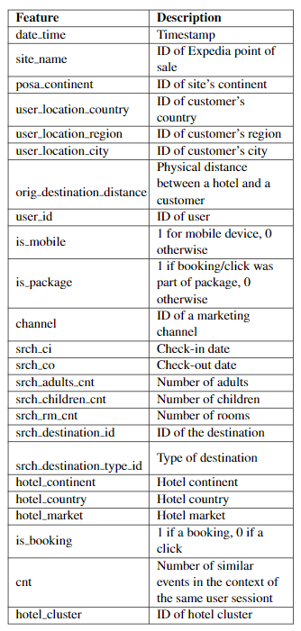
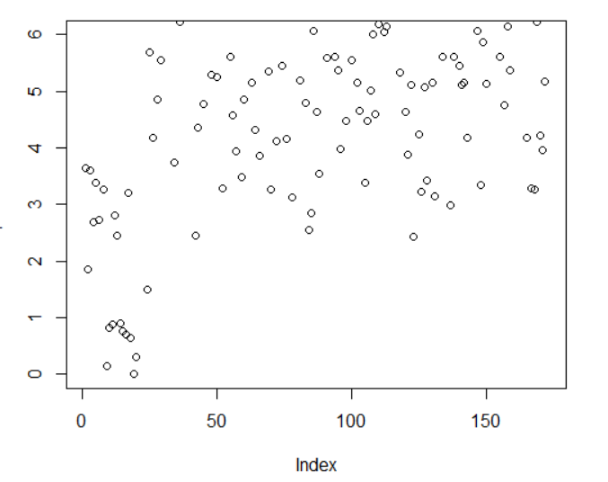
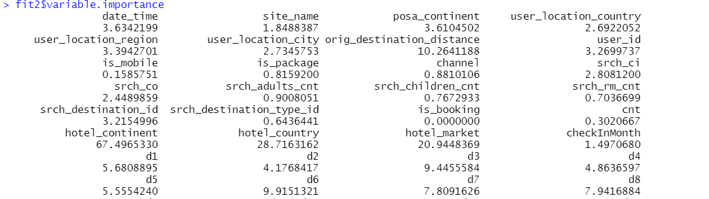
Features:
Geographical features
Search features
Time features
Latent features
All features are number/binary conditions

Slide 12
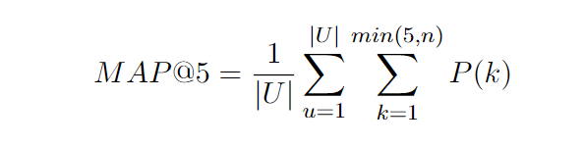


Evaluation Metric:
Because we need to give five hotel cluster recommendations.
Traditional measures like: The MSE/MAE are not work well.
We will use Mean Average precision @k=5
Where |U|is the number of user events,P(k)is the precision at cutoff k and n is the number of predicted hotel clusters.
In the other words, mapk(k, actual, predicted)

Slide 13

Our Models will be >>
Ranger: a faster implementation of randomForest,Especially suitable for high-dimensional data, supporting classification, regression and survival analysis
Bagging
Tree Based methods
Random Forest
Ranger
Most of the data provided was categorical which can be handled by tree based models without needing any conversion.
Advantages & Disadvantages
Advantage
Ability to estimate which feature is more important in classification.
"out of the box" model - few parameters need to be tuned.
Has built-in validation set - no need to sacrifice data for additional validation.
No pre-processing is required.
Handling of outliers is powerful.
Suitable for a large number of unknown features in the dataset.
Disadvantages
It can be very slow when computing large data.
There may be some trees with very small differences that overwhelm some correct decisions.

Slide 14
Our Solution
7

Slide 15
Conclusion:
We ranked the problem at hand as a multi-class classification problem and maximized the probabilities of each cluster, picking the top five clusters.
Challenging part_1: create and extract useful features out 38 million data points. The large size of the train data to train the model and will have great impact on predictions on hotel_cluster.
Challenging part_2: Combine different dataset and Formatting into submission. The time and data size weight is also a problem when we train the model.
We also test different classification model such as SVM to check for the MAP5. And we find the SVM is not work well in our dataset, For example, SVM, there are many hyperparameters that need to be adjusted, such as choosing the most suitable kernel function, regularization penalty, etc. On small data, SVM is excellent, while random forest has a large demand for data.

Slide 16
Questions?

